Slide 1
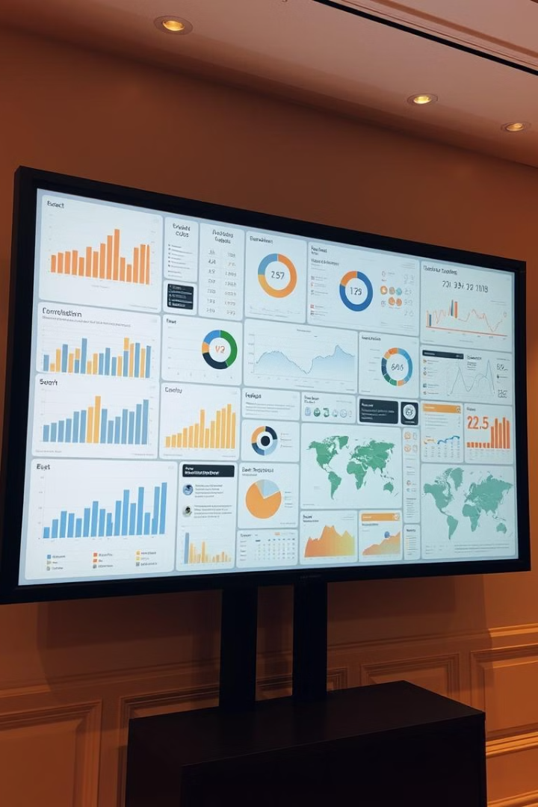
Data Visualization of CSE Faculty at NITJ
This research project focuses on analyzing and visualizing data collected from the official NITJ website regarding CSE faculty members. The goal is to present a comprehensive overview of their research contributions through various visual representations.

Slide 2

Group Members
Student Name
Roll Number
Branch
Group
Subject
Abhay Bansal
23103002
CSE
G1
DVPD
Aditya Kumar Maurya
23103008
CSE
G1
DVPD
Aman Kumar
23103011
CSE
G1
DVPD
Ankit Singh
23103014
CSE
G1
DVPD
Harshit Kumar Vaibhav
23103065
CSE
G3
DVPD
DVPD Project

Slide 3

Data Collection from the NITJ Website
1
Web Scraping
Automated extraction of faculty data from the NITJ website using Python libraries.
2
Data Cleaning
Removing inconsistencies and errors in the collected data for accuracy.
3
Data Structuring
Organizing the extracted data into a suitable format for analysis and visualization.
DVPD Project

Slide 4

Analyzing CSE Faculty Data
Faculty Name
Journal
Publications
Citations
H-Index
Research Interests
Dr. Amritpal Singh
83
1514
21
Machine Learning,
probabilistic Data Str.
Dr. Nagendra Pratap
15
298
09
Machine Learning,
Computer
vision
Dr. Rajneesh Rani
50
274
09
Digital image processing,
ML.
…… and more
DVPD Project

Slide 5

Visualizing Data with Python Language
1
matplotlib
2
Seaborn
Matplotlib is a powerful plotting library in Python used for creating static, animated, and interactive visualizations.
A library built on top of Matplotlib, offering a high-level interface for statistical data visualization.
3
Plotly
A library for creating interactive web-based visualizations with the ability to create various chart types.

Slide 6
Graphs for Publications and H-Index
H-INDEX
Journal Publications
Conference Proceedings
A scatter plot can show the relationship between Faculty Member and H-Index for each faculty member.
A bar chart can represent the distribution of publications across different journals.
A pie chart can illustrate the percentage of publications presented at various conferences.
DVPD Project

Slide 7
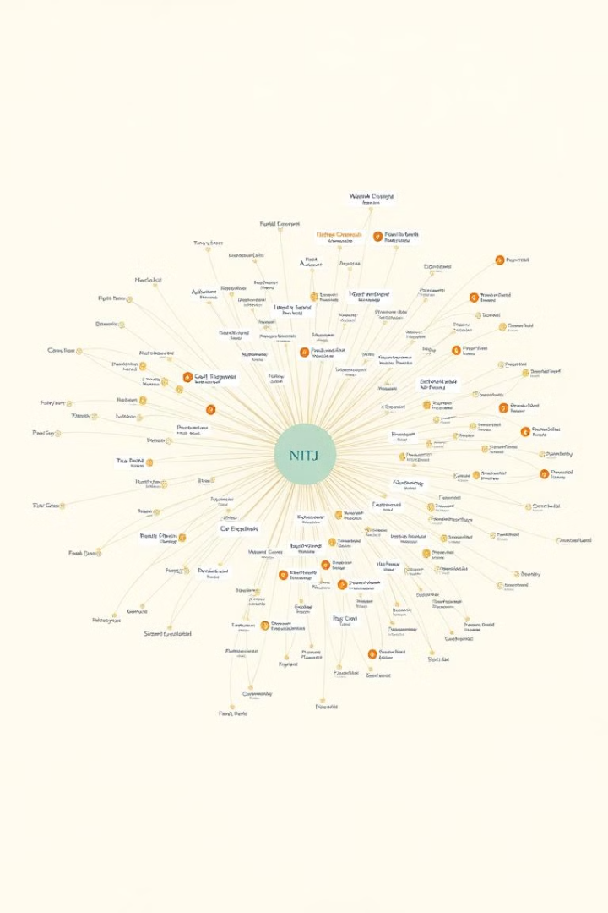
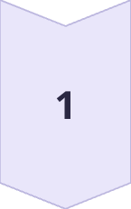
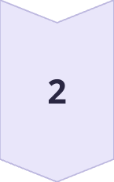
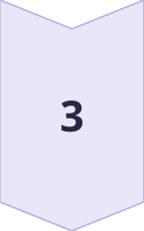
Graphs for Books, H-Index, and Co-authors
Journal Publications
A bar chart can depict the number of Journal publications published by each faculty member.
H-index
A scatter plot can visualize the distribution of H-index scores for the faculty.
Co-author Analysis
A network graph can show the collaboration patterns between faculty members.
DVPD Project

Slide 8

Determining Suitable Graphs
Data Type
Research Question
Audience
Choosing graphs based on the type of data being represented, such as categorical, numerical, or time series.
Selecting visualizations that answer specific research questions and provide meaningful insights.
Considering the target audience and tailoring the visualizations for their understanding and comprehension.
DVPD Project

Slide 9
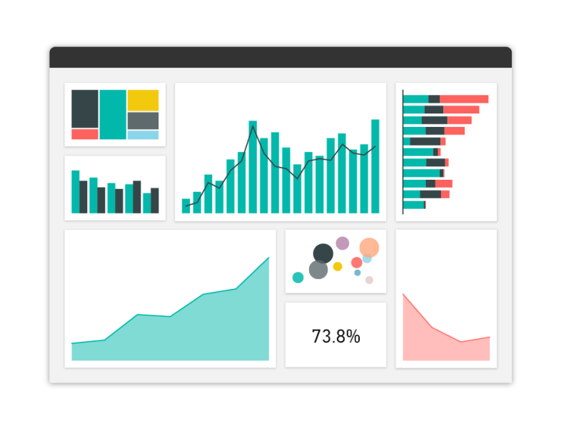
Dataset Used – Table 1
PROFESSORS | CITATIONS | JOURNAL | CONFERENCE PROCEEDINGS | BOOKS | H-INDEX | CO-AUTHOR | PUBLICATION
1) Rajneesh Rani | 274 | 50 | 32 | 0 | 9 | 180 | 88
2) Amritpal Singh | 514 | 83 | 24 | 3 | 21 | 168 | 122
3) Narendra Pratap | 298 | 15 | 14 | 0 | 9 | 15 | 29
4) Shefali Arora | 93 | 7 | 6 | 3 | 7 | 24 | 18
5) Banalaxmi | 142 | 4 | 2 | 0 | 4 | 8 | 6
6) Lala Tendu | 26 | 3 | 4 | 0 | 4 | 2 | 7
DVPD Project

Slide 10
Dataset Used – Table 2
NAME | PUBLICATION | CITATION | H INDEX | JOURNAL ARTICLE | CONFERENCE PROCEEDING | CO-AUTHOR
Dr. Harsh Kumar Verma | 1972-2023 | 1083 | 23 | 171 | 71 | 356
Dr.Samay Veer Singh | 2010-2024 | 1035 | 17 | 60 | 35 | 285
Dr. Prashant Kumar | 2010-2022 | 93 | 6 | 14 | 22 | 117
Dr. Kuldeep Kumar | 1980-2023 | 42 | 14 | 68 | 28 | 131
Dr. Avtar Singh | 2023-2024 | 18 | 2 | 8 | 6 | 38
Dr. Krishna Pal Sharma | 2014-2024 | 145 | 7 | 42 | 39 | 471
DVPD Project

Slide 11

CODE
import matplotlib.pyplot as plt
professors = ['Amritpal Singh', 'Banalaxmi', 'Lala Tendu', 'Narendra Pratap', 'Rajneesh', 'Shefali Arora’]
journals = [85, 10, 5, 25, 70, 15]
plt.bar(professors, journals, color='lightblue’)
plt.title('Number of Journal Published by Professor’)
plt.xlabel('Professor Name’)
plt.ylabel('No of Journals’)
plt.xticks(rotation=45, ha='right’)
plt.tight_layout()
plt.show()
DVPD Project

Slide 12
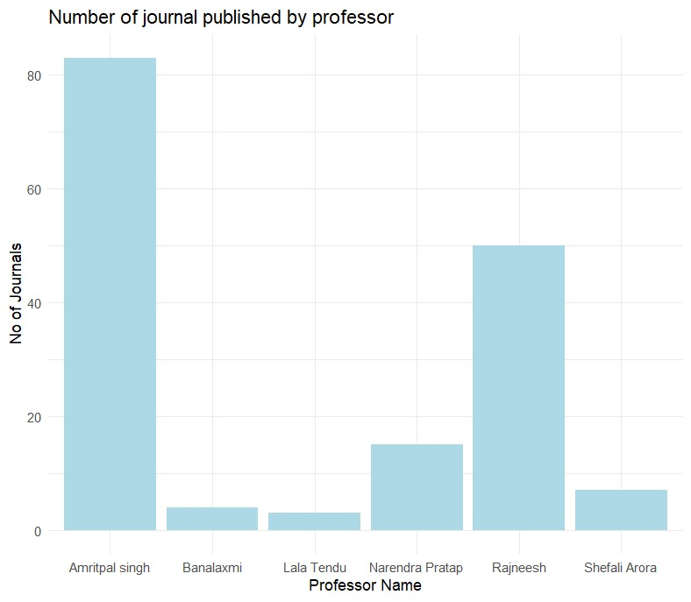
DVPD Project

Slide 13

Data Analysis
The graph highlights the variation in journal publications among professors.
Amritpal Singh stands out with the highest number of journals published, indicating exceptional research output.
Rajneesh follows as the second-highest contributor.
In contrast, professors like Narendra Pratap, Shefali Arora, Banalaxmi, and Lala Tendu have considerably fewer publications, with Banalaxmi and Lala Tendu at the lowest.
This disparity suggests differences in research focus, experience, or productivity among the faculty members.
Professors with higher journal contributions may be leading in academic activities, while those with lower counts may need additional support or resources to enhance their research output.
DVPD Project

Slide 14
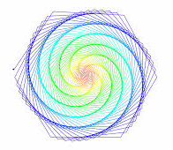
CODE
import matplotlib.pyplot as plt
import numpy as np
professors = ['Rajneesh', 'Amritpal Singh', 'Narendra Pratap', 'Shefali Arora', 'Banalaxmi', 'Lala Tendu']citations = [300, 500, 200, 100, 120, 50]
journal = [50, 100, 40, 20, 30, 10]
h_index = [30, 60, 20, 10, 15, 5]
publications = [20, 40, 15, 10, 10, 5]
citations = np.array(citations)
journal = np.array(journal)
h_index = np.array(h_index)
publications = np.array(publications)
x = np.arange(len(professors))
plt.bar(x, citations, label='Citations', color='orange’)
plt.bar(x, journal, bottom=citations, label='Journal', color='red’)
plt.bar(x, h_index, bottom=citations + journal, label='H-Index', color='pink’)
plt.bar(x, publications, bottom=citations + journal + h_index, label='Publications', color='magenta’)
plt.xticks(x, professors, rotation=45, ha='right’)
plt.ylabel('Metrics’)
plt.title('Stacked Bar Chart of Selected Academic Metrics for Professors’)
plt.legend(title='Metrics’)
plt.tight_layout()
plt.show()
DVPD Project

Slide 15
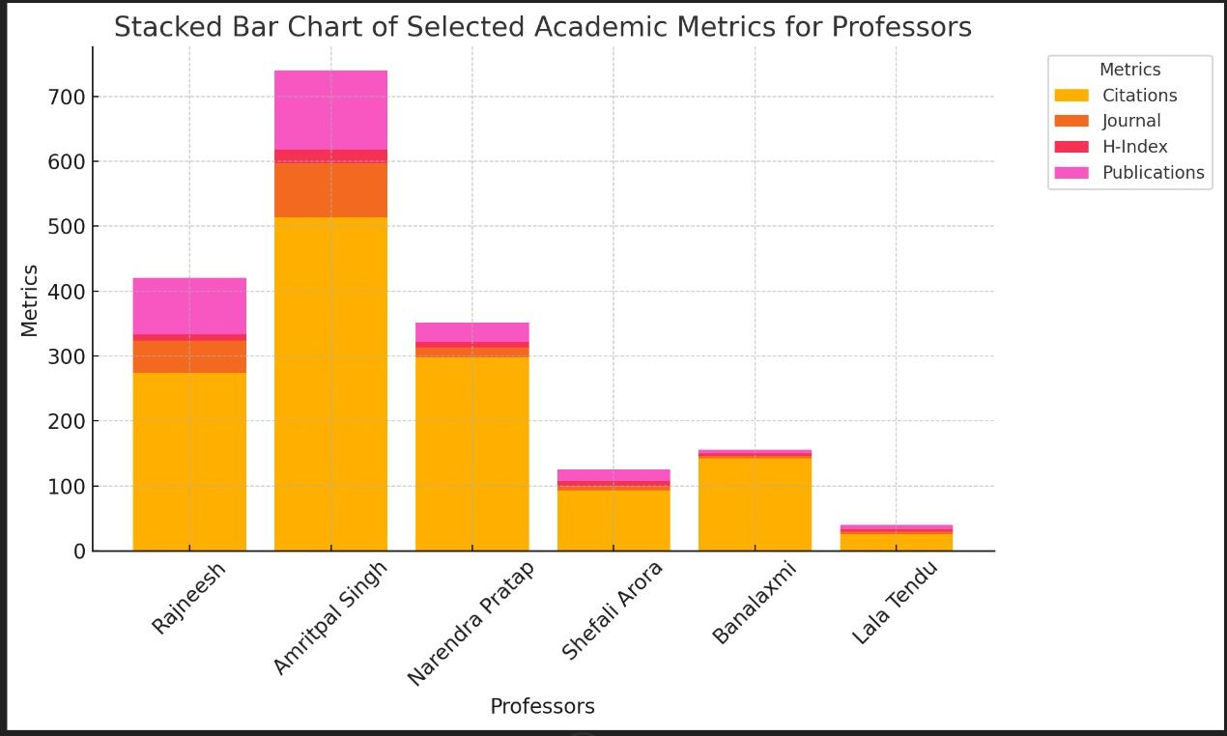
DVPD Project

Slide 16

Data Analysis
The graph illustrates the academic metrics of professors.
Amritpal Singh leads across all metrics (Citations, Journal, H-Index, and Publications), showing exceptional academic performance.
Rajneesh and Narendra Pratap follow, contributing significantly.
In contrast, Shefali Arora, Banalaxmi, and Lala Tendu have lower metrics, highlighting disparities in research productivity among professors.
DVPD Project

Slide 17

CODE
import matplotlib.pyplot as plt
professors = ['Amritpal Singh', 'Banalaxmi', 'Lala Tendu', 'Narendra Pratap', 'Rajneesh', 'Shefali Arora’]
citation = [500, 50, 30, 300, 400, 100]
journal = [80, 10, 5, 20, 70, 15]
conference_proceedings = [10, 5, 3, 8, 10, 2]
books = [5, 2, 1, 3, 4, 1]
h_index = [100, 20, 10, 50, 70, 25]
co_author = [10, 5, 3, 8, 12, 5]
publication = [50, 15, 8, 30, 40, 10]
plt.plot(professors, citation, marker='o', label='Citation’)
plt.plot(professors, journal, marker='o', label='Journal’)
plt.plot(professors, conference_proceedings, marker='o', label='Conference_Proceedings’)
plt.plot(professors, books, marker='o', label='Books’)
plt.plot(professors, h_index, marker='o', label='H_Index’)
plt.plot(professors, co_author, marker='o', label='Co_Author’)
plt.plot(professors, publication, marker='o', label='Publication’)
plt.title('Line Chart of Academic Metrics for Professors’)
plt.xlabel('Professors’)
plt.ylabel('Value’)
plt.legend(title='Variable’)
plt.xticks(rotation=45, ha='right’)
plt.tight_layout()
plt.show()
DVPD Project

Slide 18
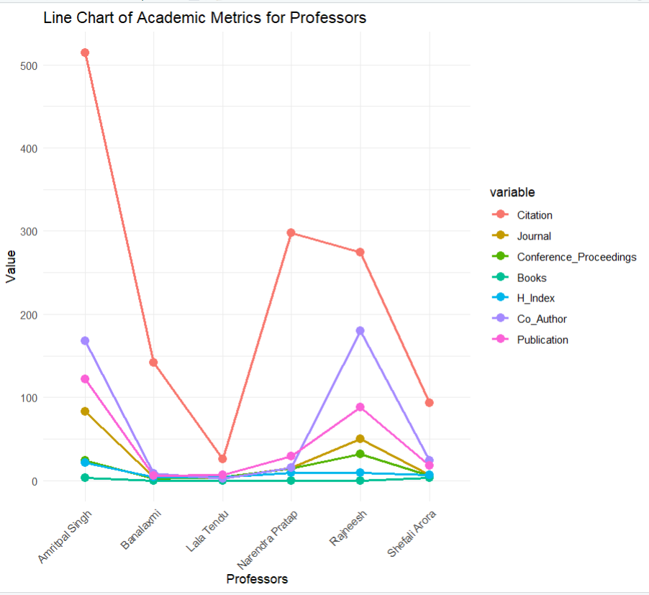
DVPD Project

Slide 19
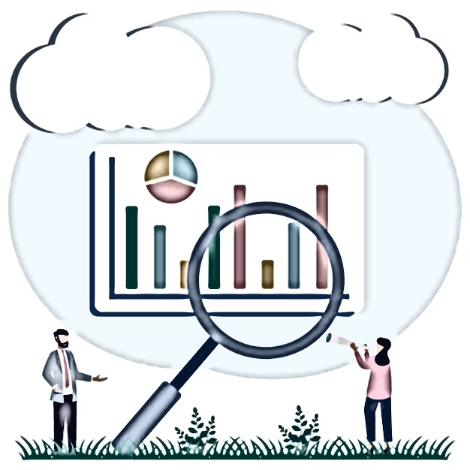
Data Analysis
The graph shows academic metrics for six professors.
Key takeaways:Amritpal Singh leads in citations and total publications.
Shefali Arora excels in journal publications.
Narendra Pratap focuses on conference proceedings.
Banalaxmi has the most book publications.
Rajneesh has the highest H-index and co-authors.
Remember, this is a limited view.
More data is needed for a complete analysis.
DVPD Project

Slide 20
CODE
import matplotlib.pyplot as plt
professors = ['Amritpal Singh', 'Banalaxmi', 'Lala Tendu', 'Narendra Pratap', 'Rajneesh', 'Shefali Arora’]
h_index = [20, 3, 5, 10, 10, 6]
plt.scatter(professors, h_index, color='blue’)
plt.title('Scatter plot of H. Index of different faculty member’)
plt.xlabel('Professor name’)
plt.ylabel('H. Index’)
plt.xticks(rotation=45)
plt.show()
DVPD Project

Slide 21
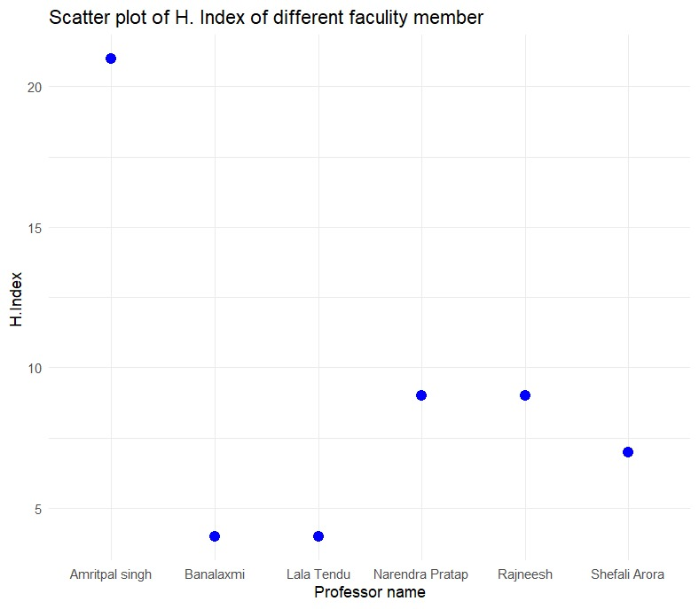
DVPD Project

Slide 22

Data Analysis
The scatter plot illustrates the H-index of six faculty members.
H-index is a measure of a researcher's scientific research output and citation impact.
A higher H-index generally signifies a greater research influence.
From the plot, we can observe that:Amritpal Singh holds the highest H-index, suggesting a substantial impact of their research.Rajneesh and Banalaxmi also exhibit relatively high H-indices, indicating significant research contributions.
The remaining faculty members, Lala Tendu, Narendra Pratap, and Shefali Arora, have lower H-indices, suggesting a lower level of research impact compared to the top performers.
It's important to note that while H-index is a valuable metric, it should be considered in conjunction with other factors like the specific research field, publication quality, and citation patterns to get a comprehensive understanding of a researcher's impact.
DVPD Project

Slide 23
CODE
import matplotlib.pyplot as plt
import seaborn as sns
import numpy as np
import pandas as pd
# Data from the stacked bar
chartdata = { "Professors": ["Rajneesh", "Amritpal Singh", "Narendra Pratap", "Shefali Arora", "Banalaxmi", "Lala Tendu"], "Citations": [300, 700, 400, 100, 200, 50], "Journal": [50, 100, 50, 20, 30, 10], "H-Index": [30, 50, 40, 10, 20, 5], "Publications": [70, 150, 100, 30, 50, 15]}
# Convert the data into a DataFrame
df = pd.DataFrame(data)
df.set_index("Professors", inplace=True)
# Plotting the heatmap
plt.figure(figsize=(10, 6))
sns.heatmap(df, annot=True, fmt="d", cmap="YlGnBu", linewidths=0.5)
# Adding labels and title
plt.title("Heatmap of Academic Metrics for Professors")
plt.ylabel("Professors")
plt.xlabel("Metrics")
# Show the plot
plt.tight_layout()
plt.show()
DVPD Project

Slide 24
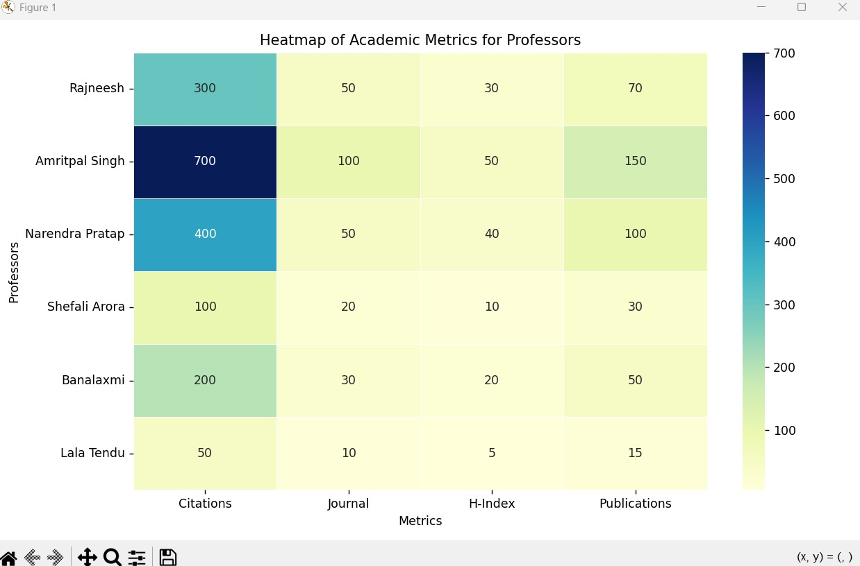
DVPD Project

Slide 25

Data Analysis
The heatmap provides a visual comparison of academic metrics for different professors.
Here are the key takeaways:Amritpal Singh has a strong performance across all metrics, particularly in citations and total publications.
Shefali Arora excels in journal publications, suggesting a focus on high-quality research.
Rajneesh has the highest H-index, indicating significant research impact.
Banalaxmi shows a balanced performance across metrics, suggesting a well-rounded research profile.
By comparing the color intensities, we can identify strengths and weaknesses of each professor's academic performance.
DVPD Project

Slide 26
CODE
import matplotlib.pyplot as plt
# Data from the table (extract conference proceeding values)
conference_proceedings = [71, 35, 22, 28, 6, 39, 32, 14, 3, 12]
# Create a boxplot
plt.boxplot(conference_proceedings)
# Add labels and title
plt.xlabel('Conference Proceedings’)
plt.ylabel('Number of Proceedings’)
plt.title('Box Plot of Conference Proceedings’)
# Show the plot
plt.show()
DVPD Project

Slide 27
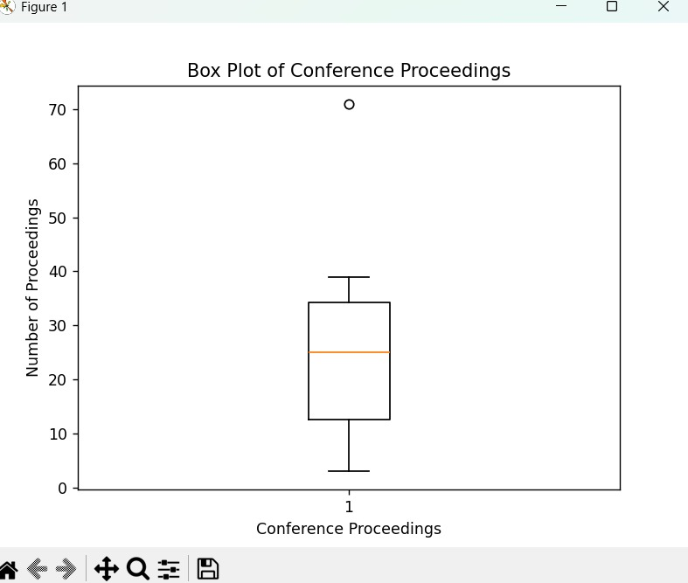
DVPD Project

Slide 28
Data Analysis
The box plot visualizes the distribution of conference proceedings for the given faculty members.
Key insights:Median: Around 30 conference proceedings.
Spread: Moderate variability in the number of proceedings.
Outliers: A few faculty members with significantly higher proceedings.
This analysis can help identify top performers and understand the overall distribution of conference participation.
DVPD Project

Slide 29
CODE
import matplotlib.pyplot as plt
# Assuming you have extracted the citation data into a list called 'citations’
citations = [1083, 1035, 93, 42, 18, 145, 274, 298, 93, 722]
# Sort the data in descending
ordercitations.sort(reverse=True)
# Create a figure and axisfig,
ax = plt.subplots()
# Create the funnel
chartax.barh(range(len(citations)), citations, color='skyblue’)
# Customize the
chartax.set_yticks(range(len(citations)))
ax.set_yticklabels([f'Faculty {i+1}’
for i in range(len(citations))])
ax.set_xlabel('Citations’)a
x.set_title('Funnel Chart of Citations’)
# Show the plot
plt.show()
DVPD Project

Slide 30
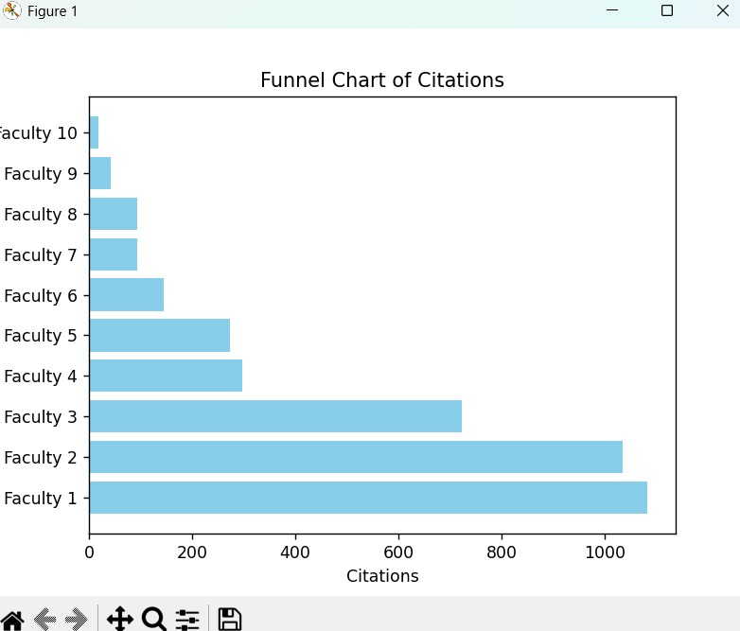
DVPD Project

Slide 31
Data Analysis
The funnel chart visualizes the distribution of citations among the faculty members.
It highlights the top performers with high citation counts and shows a decreasing trend as we move down the funnel.
This helps identify disparities in research impact and potential areas for improvement.
DVPD Project

Slide 32
CODE
import seaborn as sns
import matplotlib.pyplot as plt
import pandas as pd
# Sample data (replace with your actual data)
data = {'Metrics': ['Citations', 'Journal', 'H-Index', 'Publications'], 'Values': [1000, 800, 600, 400, 200, 0, -200, 100, 50, 25, 10, 5, 2, 1, 100, 50, 20, 10, 5]}
# Create a DataFramedf = pd.DataFrame(data)
# Create the violin plot
sns.violinplot(x='Metrics', y='Values', data=df)
# Customize the plot
plt.title('Violin Plot of Academic Metrics for Professors’)
plt.xlabel('Metrics’)
plt.ylabel('Values’)
# Show the plot
plt.show()
DVPD Project

Slide 33
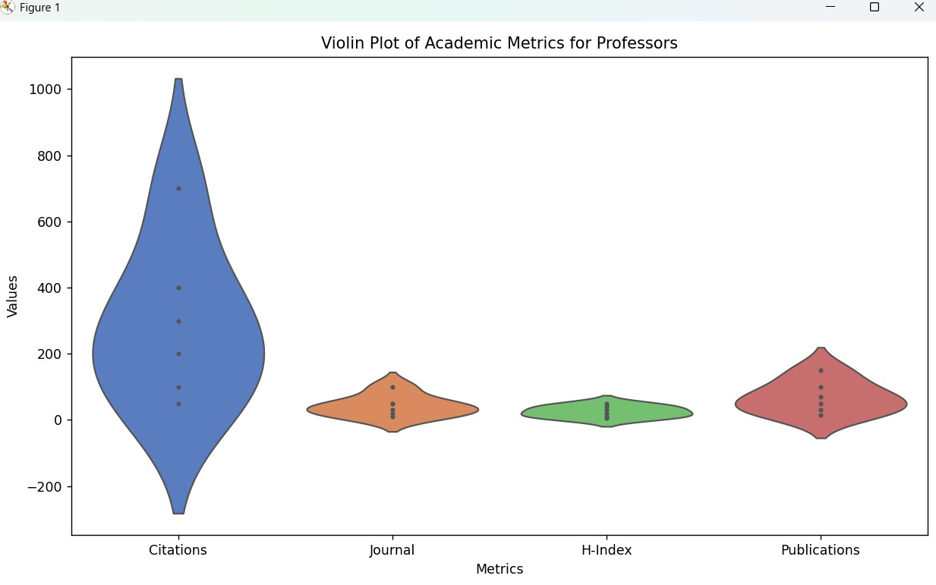
DVPD Project

Slide 34
Data Analysis
The violin plot shows the distribution of academic metrics for professors.
Key insights:Citations: Skewed right, indicating a few professors with significantly higher citations.
Journal: More symmetric distribution, suggesting a more even distribution of journal publications.
H-Index: Relatively symmetric distribution, indicating a moderate range of H-index values.
Publications: Skewed right, similar to citations, suggesting a few professors with a higher number of publications.
Overall, the violin plot provides a comprehensive view of the distribution of academic metrics.
DVPD Project

Slide 35
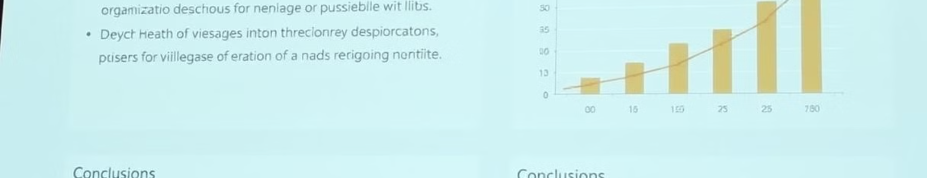



Conclusion and Key Takeaways
Research Impact
Collaboration Patterns
Knowledge Sharing
The visualizations provide a clear picture of the research contributions of CSE faculty at NITJ.
The visualizations reveal collaboration patterns and research trends among the faculty.
The visualizations contribute to the sharing of research knowledge and insights within the academic community.
DVPD Project

